Slide 1
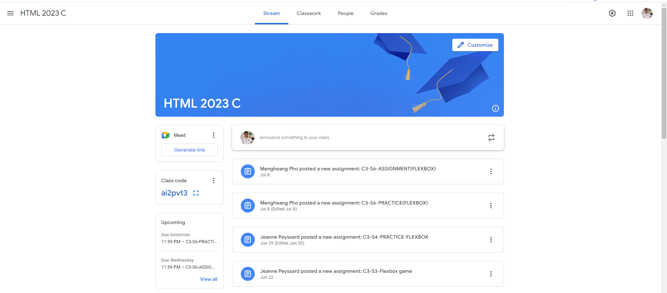
Identify root components of website below

Slide 2
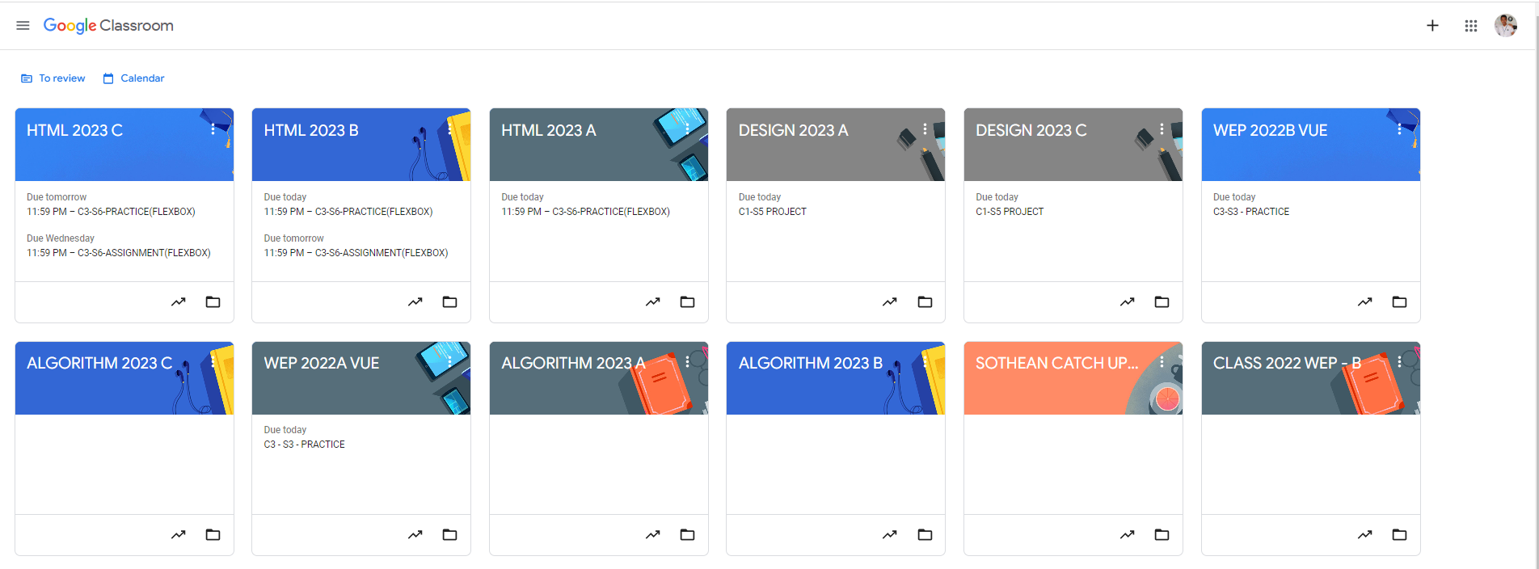
Root div
- Height: 100vh
content
nav
Flex: 0
header
Flex: 0
Flex: 1

Slide 3
Nav
main

Slide 4
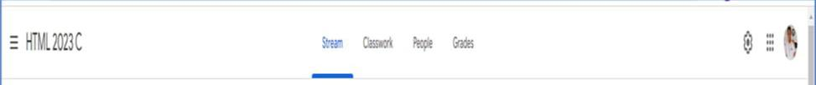
Header-left
Header-right (container-right)
Second-header-left
Second-header-right
Flex: 1
Flex: 2
Flex-direction: row

Slide 5

Sub header
Tittle
Flex: 0
Main-content
Flex: 1
Flex-direction: column

Slide 6
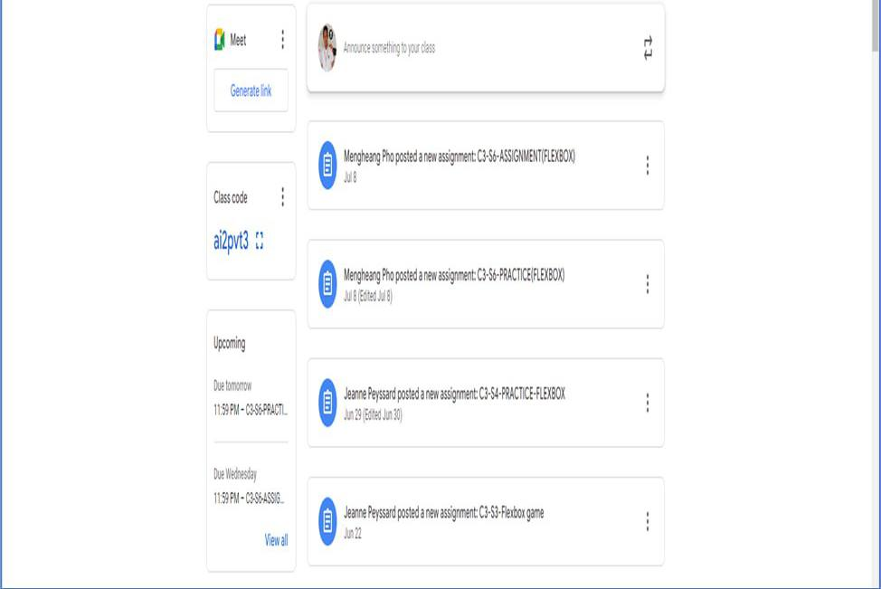
Flex: 0
Flex: 1
Left-Side
Right-Side
Flex-direction: row

Slide 7
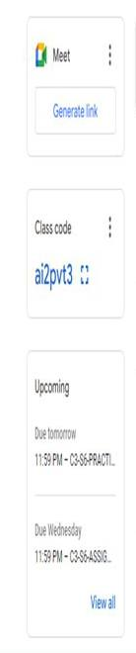
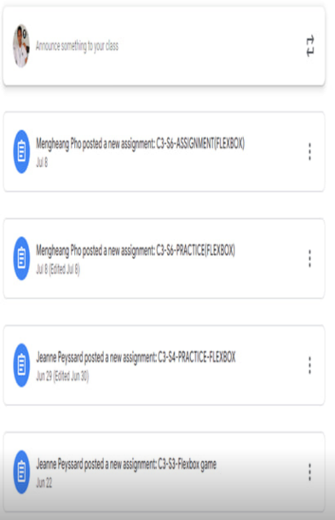
All items have the flex grow 1:
Item: 1
Flex: 0
Item 1
Item 2
Item:
2
Flex: 0
Item 3
Item:3
item4
Flex: 1
tem5
Flex-direction: column
Flex-direction: column

